Slide 1
Comparative Analysis of Convex Regularization and First-Order Optimization Methods for Image Deblurring

Slide 2

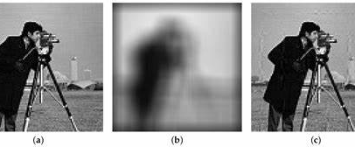
Introduction to Image Deblurring
Core Concept
Image deblurring is a classical ill-posed inverse problem.
Goal:
Recover sharp image from blurred and noisy observation.
Original
Blurred
Deblurred
Forward Model
F= Ku + n
u=K^−1(f−n)
(a) Sharp ground truth image | (b) Degraded observation with blur and noise | (c) Reconstructed result using inverse methods
Model
Notes:
inverse may not exist
inverse may not be unique
tiny noise causes huge reconstruction errors

Slide 3

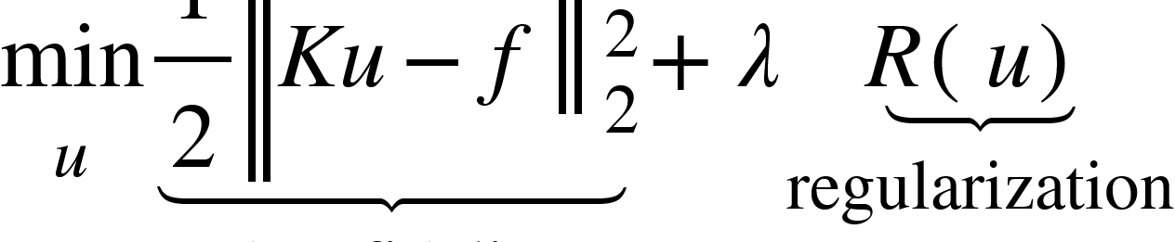
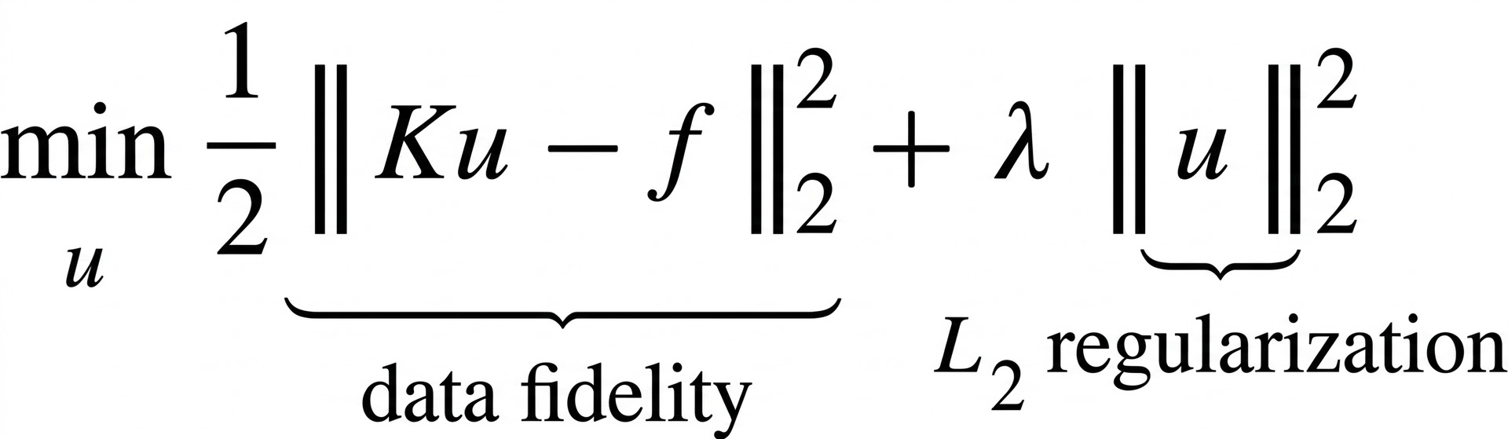
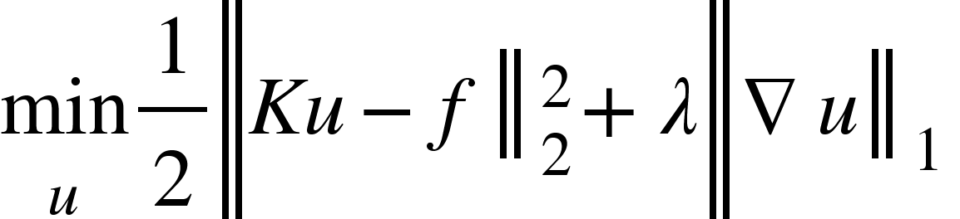
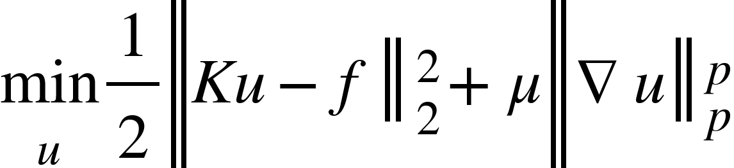
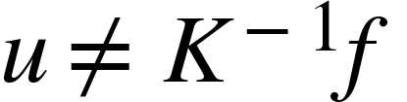
Problem Statement
Forward Imaging Model
Degraded observation model:
f = Ku + n
u: Sharp, unknown image
K: Blur operator (convolution)
n: Additive noise
f: Degraded observation
Objective
Solve inverse problem for u. Direct inversion is ill-posed:
General Optimization Formulation
L2 Regularization
TV Regularization
Non-convex sparse prior
→ Need regularized reconstruction
Notes:
This is the central difficulty L2: Do not allow pixel values to become too large. Good for smooth images. Bad for edges → causes oversmoothing
TV: Instead of penalizing pixel values, penalises image gradients.
Why L2 in here? promotes sparsity, only important edges remain, Assumes image gradients are sparse, works best for restoration Sparse: it says most regions in images are smooth, but edges should remain sharp we want stringer sparsity, but non convex so might be issues like local min, unstable covg., but potenstially the best img resto quality.

Slide 4

Motivation
Regularization Models
Produce different restoration behaviors:
L2 regularization
Total Variation (TV)
Sparse / non-convex models
Project Objective
Study the critical trade-offs between regularization choices and solver efficiency.
Study Trade-offs:
Quality of image reconstruction
Speed of algorithmic convergence
Efficiency in overall computation
Optimization Solvers
Solve the same model differently:
Gradient Descent & FISTA
ADMM
Primal-Dual
Split Bregman
Optimization
Regularization
Image Quality
Notes:
Instead of directly inverting, we solve: minimisation of data fidelity+regularisation This stabilizes the solution. L2: Good for smooth images. Bad for edges → causes oversmoothing
TV: Assumes image gradients are sparse, works best for restoration, and avoids oversmooting, Sparse: Uses stronger sparsity assumptions, But optimization becomes much harder because: non convex prob. Solver: the method used to actually find the best solution of an optimization problem Reg: WHAT to opt Solver: HOW to opt
Which combination of regularization model and optimization solver gives the best image deblurring performance?

Slide 5
Assumptions and Optimization Setting
Key Assumptions
Blur is spatially invariant
Blur kernel K known (non-blind deblurring)
Additive Gaussian noise
Images modeled as piecewise smooth
Gradient sparsity prior holds
Solvers Investigated
Gradient Descent
FISTA
ADMM
Primal-Dual
Split Bregman
PIRL1-AM / APIRL1-AM
Goal: Compare how regularization and optimization methods influence deblurring performance.

Slide 6
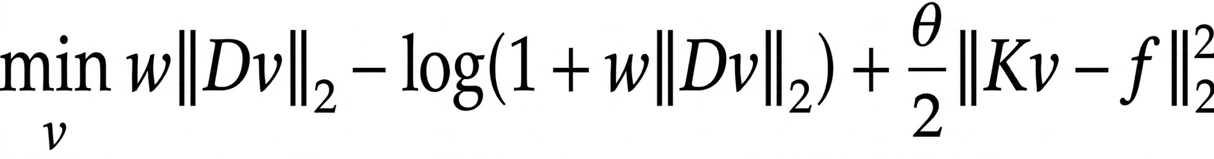
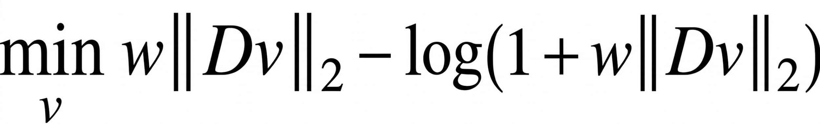
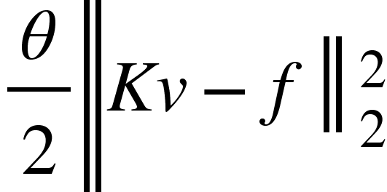
Paper 1: Hybrid Convex TV Regularization for Non-Blind Deblurring
Optimization Model
Variable Definitions
v : restored image
K : blur operator
f : observed blurred image
D : discrete gradient operator
w, θ : regularization parameters
Data Fidelity
Objective term ensuring the model matches observations.
Matches reconstruction to observations
Hybrid Convex TV
Advanced penalty term for noise suppression.
Promotes edge preservation
Suppresses artifacts
Convex hybrid TV penalty
Notes:
Paper 3 improves classical TV regularization by introducing a hybrid convex TV penalty that preserves edges, suppresses staircase artifacts, and achieves superior deblurring performance using ADMM optimization. not pure TV, not pure L2. AdMM: Because image restoration problems often have: TV norms, L1 penalties, constraints, non-smooth priors we checked that on BSD100 and even text-img, works stablly for both

Slide 7




Paper 2: Accelerated Proximal Iterative Reweighted ℓ1 Alternating Minimization
Problem Addressed
Non-convex image deblurring using sparse regularization
Goal: Recover sharp image u from blurred observation
Optimization Model
One way to solve Model for the image u is by minimizing the nonconvex nonsmooth composite optimization problem
Proposed Methods & Key Ideas
PIRL1-AM / APIRL1-AM (Accelerated)
Iteratively reweighted L1 minimization
Alternating minimization
Nesterov acceleration
Main Findings
Faster convergence achieved with APIRL1-AM
Improved computational efficiency
Maintaining Competitive reconstruction quality compared to benchmarks
Notes:
Problem → Model → Difficulty → Solution → Result
“Non-convex” “hard to solve” “three key techniques” “faster convergence”
This Paper Focuses on ___. Given a Blured image Modelled as f = ____. To solve this, the paper formulates an optimization problem with two terms:
a data fidelity term and a non-convex ℓp regularization term. Here, This ℓp term enforces stronger sparsity for better edge recovery. This ℓp term enforces stronger sparsity for better edge recovery. How Ever The Difficulty is, ℓp (p < 1) is non-convex Which is Hard to solve directly. To address this
This paper solves it using 3 key techniques
First, iterative reweighted ℓ1, which approximates the non-convex problem using simpler convex problems. Convert hard ℓp problem → easier ℓ1 problem and Update weights every iteration
Second, alternating minimization, which splits the problem into smaller subproblems. - Update z (gradient) , Update u (image)
👉 Solve them one-by-one instead of together
Third, acceleration using Nesterov momentum in APRIMl1-AM to improve convergence speed
“As a result, the accelerated version ____ and PIRL also Get Good.
PIRL1-AM - An algorithm that solves a non-convex problem by iteratively approximating it using weighted ℓ1 minimization and alternating updates.
APIRL1-AM - An accelerated version of PIRL1-AM that uses momentum to achieve faster convergence.
6 PIRL1-AM Algorithm
6.1 z-update
6.2 u-update
7 APIRL1-AM(AcceleratedVersion)
Acceleration is introduced using Nesterov momentum

Slide 8
Paper 3: Total Variation Regularization via Alternating Minimization
Optimization Model
Methodology
TV regularization
Alternating minimization
Soft-thresholding
Conjugate gradient subsolver
Contributions
Edge-preserving deblurring
Stable convergence
Improved PSNR/SSIM
Notes:
Now I will explain Paper 3, which also focuses on Total Variation based image deblurring.
The optimization model is similar to previous methods, where we minimize two terms:
a data fidelity term, which ensures the reconstructed image matches the blurred image
and a TV regularization term, which helps preserve edges while removing noise
In terms of methodology, this paper uses alternating minimization, where the problem is solved step by step instead of all at once.
It includes:
TV regularization for edge preservation
soft-thresholding to remove noise
and conjugate gradient to efficiently update the image
The main contributions of this method are:
edge-preserving deblurring
stable convergence due to convex optimization
and improved PSNR and SSIM values
So overall, this method provides a stable and effective way to restore images while keeping important details like edges.”

Slide 9
Implementation Framework
Papers Implemented
Replication of Three Literature Methods
PIRL1-AM and APIRL1-AM
TV Alternating Minimization
Hybrid Convex TV (ADMM)
Additional Optimization Models (Our Comparative Study)
Implemented and compared:
L2-based
L2 + Gradient Descent
L2 + FISTA
TV-based
TV + ADMM
TV + FISTA
TV + Primal-Dual (Chambolle–Pock)
TV + Split Bregman
Solver Families
Optimization Family | Methods
Gradient-based | GD, FISTA
Operator Splitting | ADMM, Split Bregman
Primal-Dual | Chambolle-Pock
Non-convex Reweighted | PIRL/APIRL
Notes:
Now I will explain our implementation framework.
First, we replicated three research papers, which include:
PIRL1-AM and APIRL1-AM for non-convex optimization
TV Alternating Minimization
and Hybrid Convex TV using ADMM
After that, we extended the work by implementing additional optimization methods for comparison.
We implemented both L2-based and TV-based models.
In L2-based methods, we used Gradient Descent and FISTA, which are simple but tend to oversmooth the image.
In TV-based methods, we used ADMM, FISTA, Primal-Dual, and Split Bregman. These methods preserve edges better and give higher quality results.
On the right side, we categorized all methods into solver families such as gradient-based, operator splitting, primal-dual, and non-convex methods.
This framework helped us compare different algorithms on the same deblurring problem.”

Slide 10
Datasets and Experimental Setup
Literature-Based Implementations
Paper 1: PIRL1-AM / APIRL1-AM
Dataset
• Cameraman benchmark image
Degradation
Gaussian blur kernel: 17×17
Sigma -> Controls strength of Gaussian blur
σ = 7
BSNR (Blur Signal-to-Noise Ratio ) = 30 dB
Model Parameters
p in ℓp regularization
p = 0.1 (very strong sparsity )
μ (Regularization strength)
μ = 0.01
Iterations (Number of optimization steps)
Iterations = 600 (better convergence )
Paper 2: TV Alternating Minimization
Datasets
• Camera, Coins, Moon
Degradation
• Gaussian blur + Additive noise
Implementation Details
Gradient shrinkage step
Conjugate gradient image update
Alternating minimization iterations
Evaluation
• PSNR and SSIM
Notes:
Now I will explain the datasets and experimental setup for the literature-based implementations.
For Paper 1, we used the Cameraman benchmark image. The image was degraded using Gaussian blur with a 17 by 17 kernel, sigma equal to 7, and noise level defined by BSNR of 30 dB.
For Paper 2, we used standard images such as Camera, Coins, and Moon.
These images were degraded using Gaussian blur and additive noise.
In implementation:
we used gradient shrinkage
conjugate gradient for image updates
and alternating minimization iterations
We evaluated performance using PSNR and SSIM, which measure reconstruction quality and structural similarity.”

Slide 11
Datasets and Experimental Setup
Literature-Based Implementations vs. Synthetic Benchmark
Paper 3: Hybrid Convex TV (ADMM)
Datasets
Two real test images
Two camera shake blur kernels
Setup
Gaussian noise: μ=10⁻³
Maximum iterations: 40
Metrics
PSNR, SSIM, EDR, MHD
Our Extension: Synthetic Benchmark
Synthetic Test Images
Checkerboard, Circular Waves, Rectangles, Gradient, Random Shapes
Degradation Setup
Gaussian blur: 9×9, σ=2
Noise std = 0.01
Iterations = 200
Solvers Tested
L2 (GD, FISTA), TV (ADMM, FISTA, Primal-Dual, Split Bregman)
Evaluation Metrics: 1. PSNR 2. SSIM 3. Convergence Curves 4. Objective Value Reduction
Notes:
“Now I will explain the dataset and setup for Paper 3 and our extension.
For Paper 3, we used two real test images and camera shake blur kernels.
The setup included:
Gaussian noise
and a fixed number of iterations
We evaluated results using multiple metrics such as PSNR, SSIM, EDR, and MHD.
In addition to literature experiments, we introduced our own synthetic benchmark.
We created different synthetic images like:
checkerboard
circular waves
rectangles
gradient
and random shapes
These were degraded using Gaussian blur and noise.
We tested multiple solvers including:
L2 methods like GD and FISTA
and TV-based methods like ADMM, FISTA, Primal-Dual, and Split Bregman
Finally, we evaluated all methods using:
PSNR
SSIM
convergence curves
and objective value reduction

Slide 12
Improvements & Key Contributions
Beyond Paper Replication
Additional Solver Extensions
TV + Primal-Dual (Chambolle–Pock)
TV + Split Bregman
Broadened comparison across multiple optimization paradigms.
Optimization Insights
Acceleration: Improves convergence speed significantly.
Stability: Split methods show consistent performance.
Impact: Solver choice significantly affects restoration quality.
Reconstruction Quality
TV-based methods consistently outperformed L2 methods.
Best Performer: TV-FISTA
PSNR: 36.50 dB | SSIM: 0.9099
Key Comparative Findings
Regularization choice is the primary quality driver.
Solver choice dictates convergence and efficiency.
Edge-preserving priors + accelerated solvers = Optimal Results.

Slide 13
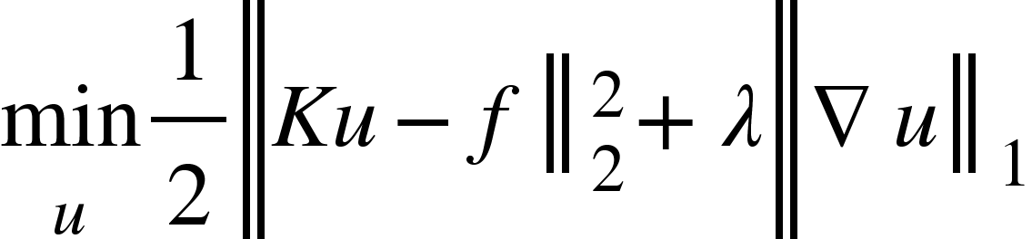
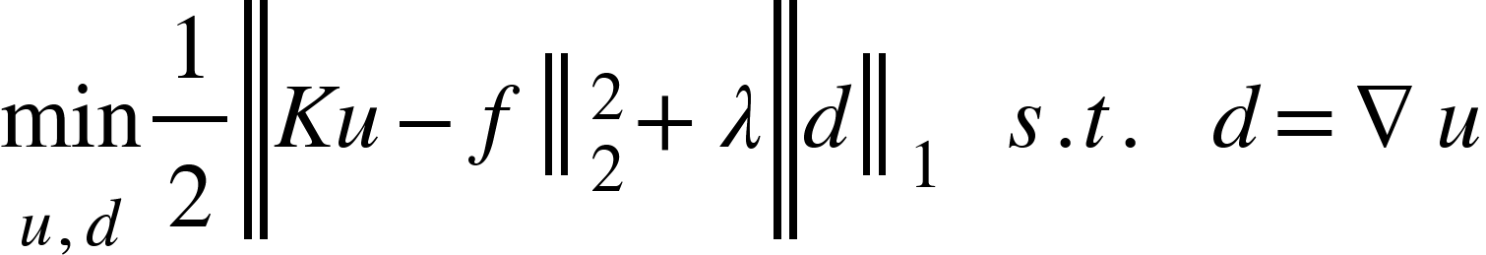
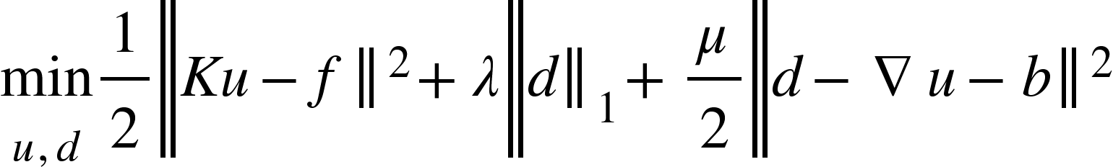
Extension Work: Additional Solver Frameworks
TV Primal-Dual (Chambolle–Pock)
Optimization Problem
Dual Update
Primal Update
Extrapolation
TV Split Bregman
Constrained Form:
Bregman Form
Bregman Update
Notes:
Why use primal-dual?
TV term is nonsmooth.
Hard to optimize directly.
Primal-dual handles:
nonsmoothness
constraints
large-scale convex problems
Efficiently.
1 Dual update
Updates edge/dual variable.
Projection enforces constraints
2 Primal update
Updates reconstructed image.
3 Extrapolation
Acceleration step.
Repeat until convergence.
That is the solve
where we minimize over the primal variable and maximize over the dual variable. The primal is minimized because it is the original reconstruction objective, while the dual is maximized to enforce constraints through duality.
A saddle point is the equilibrium where the image reconstruction objective is minimized while the dual constraints are maximized; Chambolle–Pock iteratively finds this point.
Main update steps are:
dual projection update
primal image update
extrapolation (acceleration) step
This method is useful because it handles nonsmooth convex optimization, especially TV regularization, very efficiently.
We added this as an extension to compare another modern first-order solver against ADMM, FISTA, and Split Bregman.
From our results, TV + Primal-Dual gave stable performance and served as a strong benchmark, though TV-FISTA achieved better PSNR and SSIM.
Key takeaway: Primal variable reconstructs the image, dual variable enforces edge regularization, and their coupled saddle-point optimization gives an efficient solver for TV deblurring.

Slide 14
Why TV-FISTA Performs Best
Left Side: Why TV Regularization Helps
Edge-Preserving Sparse Prior
TV regularization solves:
Why effective?
Promotes sparse gradients
Preserves edges and discontinuities
Suppresses noise without oversmoothing
Why FISTA Helps
Accelerated First-Order Optimization
FISTA convergence:
O(1/k2)
Gradient descent:
O(1/k)
Compared to L2:
smooths edges
blurs fine structures
TV preserves sharp image details.
Notes:
Perfect — use these in speaker notes:
Why TV-FISTA Performs Best
Edge-preserving TV regularization promotes sparse gradients and preserves important image details better than L2 methods.
FISTA’s accelerated convergence ((O(1/k^2))) reaches high-quality solutions faster than standard gradient-based methods.
Combination of strong regularizer and efficient solver creates a synergistic effect, improving both reconstruction quality and convergence.
Proximal updates in FISTA handle the nonsmooth TV term effectively, leading to stable optimization and reduced artifacts.
Higher PSNR and SSIM in our results show TV-FISTA achieves the best balance between noise suppression, edge preservation, and computational efficiency.

Slide 15
Performance Evaluation
A. Literature Replication Results
Paper 1
Paper 2
Paper 3
B. Synthetic Benchmark Results
Findings:
TV regularization consistently outperforms L2
TV-FISTA achieves best reconstruction quality
Split Bregman competitive with ADMM
Method | PSNR | SSIM
PIRL1-AM | 24.18 | 0.6627
APIRL1-AM | 24.22 | 0.6636
Method | Avg PSNR | Avg SSIM
L2 + GD | 29.88 | 0.8671
L2 + FISTA | 30.19 | 0.8558
TV + ADMM | 33.41 | 0.8898
TV + FISTA | 36.50 | 0.9099
TV + Primal-Dual | 30.61 | 0.8729
TV + Split Bregman | 33.41 | 0.8898
Metric | Value
Average PSNR | 29.86 dB
Average SSIM | 0.796
Model | Avg PSNR | Avg SSIM
Proposed HCTVR | 37.66 | 0.9546

Slide 16
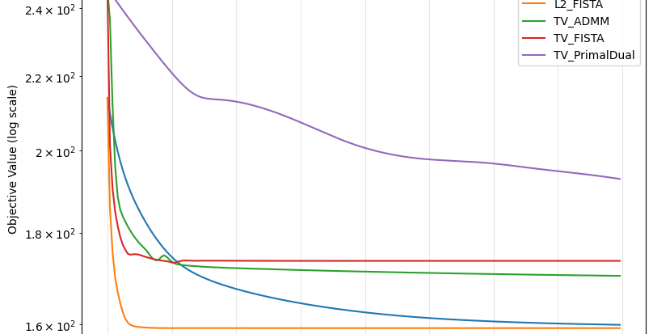
Improvements & Key Contributions
Convergence Improvement
Main Contributions
Replicated three research papers
Implemented 8+ optimization algorithms
Developed synthetic benchmarking framework
Identified TV-FISTA as best-performing solver
Unified comparative analysis
Of convex regularization and modern first-order optimization methods for image deblurring.
Faster practical convergence for FISTA

Slide 17
Learnings
Learnings
Developed understanding of image deblurring as an inverse optimization problem
Learned how convex regularization (L2, TV, Hybrid TV) stabilizes ill-posed problems
Understood difference between regularizer design and solver choice
Gained insight into first-order optimization methods:
Gradient Descent
FISTA
ADMM
Primal-Dual
Split Bregman
Learned practical implementation of PIRL/APIRL, alternating minimization, and ADMM-based solvers
Understood role of sparsity priors and edge-preserving regularization in image restoration
Learned to evaluate reconstruction quality using PSNR, SSIM, and convergence analysis
Observed how regularizer–solver combinations affect performance
Gained experience with benchmarking and comparative analysis across multiple optimization methods
Improved understanding of convex vs non-convex optimization models
Developed practical skills in algorithm implementation, debugging, and experimental analysis
Learned importance of parameter tuning and convergence behavior
Strengthened knowledge of research paper implementation and reproducibility
Improved teamwork, technical presentation, and research communication skills

Slide 18
Individual Contributions (1 slide)
Delineate the contributions of each team member

